Slide 1
SMA & HULL TACTICAL Week 7

Slide 2
Today’s Outline
Handling Outliers: Winsorize Method
Preprocessing In-Sample & Out-Sample Data
Model Selection: Regression
Model Selection: Deep Learning
Explaining Factors & Principal Components
Notes:
Main point of this week: feature filtering

Slide 3
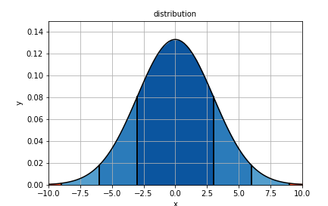
Handling Outliers

Slide 4
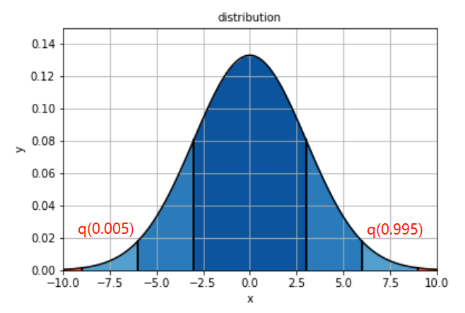
Handling Outliers: Winsorization
Notes:
Sentiment dispersion

Slide 5
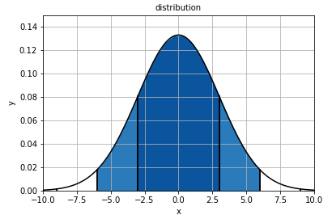
Preprocessing In-Sample & Out-Sample Data
Notes:
Sentient volumn

Slide 6
Regression Model
Notes:
Mean sentient dispersion, downward trend eliminated

Slide 7
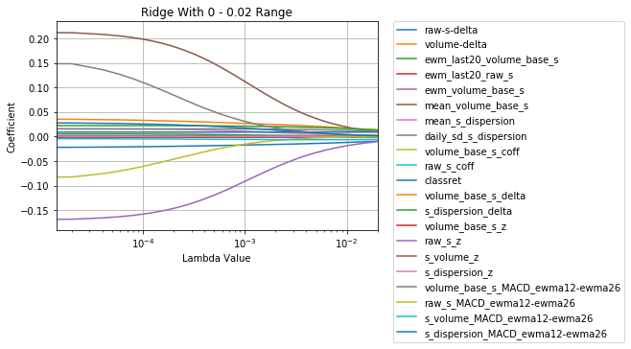
Ridge Regression
Ridge
Last 5 decayed below 1e-5:
raw_s_MACD
s_dispersion_delta
volume_base_s_delta
ewm_volume_base_s
mean_volume_base_s

Slide 8
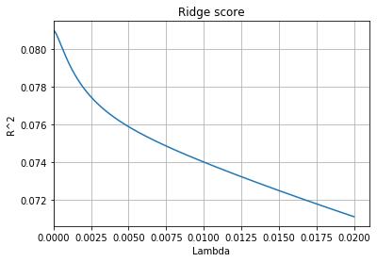
Ridge Regression
Max Score: 0.081
Notes:
Accuracy score very low, indicating linear regression not effective in prediction.
However does not affect usefulness of single factor. As long as noise filtered out, factor still useful with other models.

Slide 9
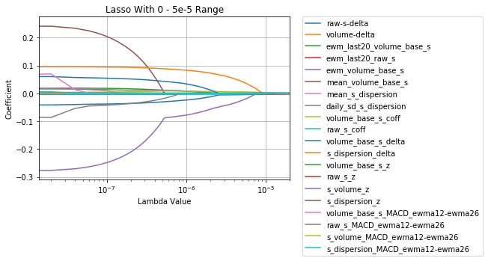
Lasso Regression
Lasso
Last 5 decayed to 0:
volume_base_s_z
raw_s_z
s_dispersion_z
raw_s_coff
ewm_last20_raw_s

Slide 10
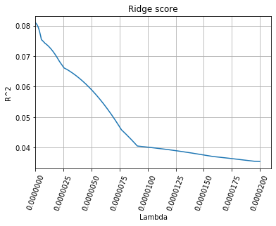
Ridge Regression
Max Score: 0.081

Slide 11
Deep Learning Model
Notes:
Mean sentient dispersion, downward trend eliminated

Slide 12
Deep Learning Model
Notes:
Mean sentient dispersion, downward trend eliminated

Slide 13
Factors & Principal Components

Slide 14
Factors & Principal Components

Slide 15
Factors & Principal Components

Slide 16
Thank you!
Notes:
PCA is orthorgonal transformation of each factor

